Slide 1

CMP1101: RECTIFIERS

Slide 2
RECTIFICATION
Is the conversion of alternating current (ac) to direct current (dc)
Generally, diodes find application in rectification since they have the ability to conduct in the forward bias and not to conduct in the reverse bias.
Small signal diodes can be applied in low-power, low- current applications or rectifiers.
Where large forward bias currents or high reverse blocking voltages are involved, larger and more robust power diodes are used instead.
Power diodes have a much large p-n junction area than the regular signal diodes.
Power diodes provide rectification of power and are used in applications such as
Battery charging
DC power supplies
AC rectifiers and inverters.

Slide 3
Rectification cont.
Where larger forward biased currents or higher reverse bias blocking voltages are involved, the p-n junction of a small signal diode would overheat and thus get destroyed.
Thus, robust power diodes are used instead.
Power diodes can be used individually or in combination to produce a variety of rectifier circuits.
Half-wave rectifiers
Full-wave rectifiers
Bridge rectifiers
Power diodes have a much larger p-n junction resulting in a higher forward current capability of up to several hundred amps (KA) and a reverse blocking voltage of up to several thousand volts (KV).
Due to their large p-n junctions, power diodes are not suitable for high frequency applications above 1MHz.

Slide 4
Rectification cont.
Each rectifier circuit can be classified as uncontrolled, half-controlled or fully controlled.
Uncontrolled rectifiers use only power diodes
Fully controlled rectifiers use thyristors
Half-controlled use a mix of diodes and thyristors.

Slide 5
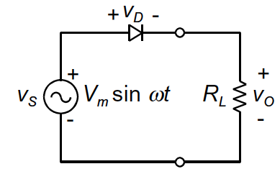
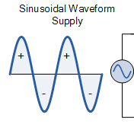
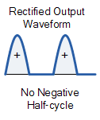
HALF-WAVE RECTIFIER
The simplest of all rectifiers, the input power supply to the half-wave rectifier being a single phase or a multi-phase.
The power diodes pass just one half of the of the sinusoidal waveform of the AC power supply, which gets converted to DC.
For every positive half cycle of the input, the diode is forward biased resulting in current flow.

Slide 6
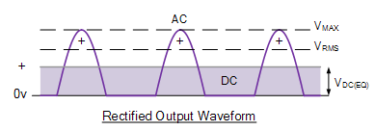

Half-wave Rectifier cont.
Since the DC load (R_{L}) is resistive, then by Ohm’s law, current flowing in the load is proportional to the voltage.
Similarly, the voltage across the load is therefore the same as the supply voltage.
For every negative half cycle of the input AC power, the diode is reverse biased and therefore no current flows diode or the circuit.
Thus no current flows through the load and therefore no voltage across the load.

Slide 7
Half-wave Rectifier with Smoothing Capacitor
Use of capacitors in rectification reduces the amount of ripple voltage resulting from the AC-DC conversion operation.
Larger value capacitors are used for this purpose but present limits from cost and size.
For a given capacitor value, a greater load current will discharge the capacitor quickly thereby increasing the ripple obtained.
Use of capacitors for smoothing in half-wave rectifiers is not very practical and thus full-wave rectification is widely applied for this purpose.
In practice, half-wave rectification is more used in low-power applications due to these main 3 disadvantages:
Output amplitude is less than the input.
No output in the negative half cycle and thus wasted power.
The output is pulsed DC, resulting in excessive ripple.

Slide 8
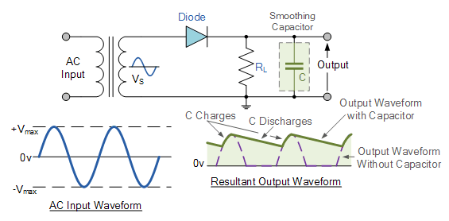
Half-Wave Rectifier with Smoothing Capacitor

Slide 9
FULL-WAVE RECTIFICATION
The use of smoothing capacitors in half-wave rectifiers is not entirely suitable for applications that need steady and smooth DC supply.
Full-wave rectifiers find wide application in this area since they used every half cycle of the input AC power to create a steady and smooth DC output.
Like the half-wave rectifiers, full-wave rectification produces an output voltage or current that is DC.
Compared to half-wave rectifiers, full-wave rectifiers have some advantages:
The average output DC voltage is higher than that achieved with half-wave rectifiers.
The output DC signal has much less ripple producing a smoother output waveform.

Slide 10
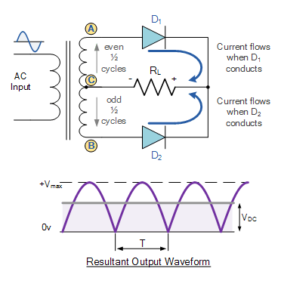
FULL-WAVE RECTIFICATION
In a full-wave rectifier, two diodes are used in conjunction with a multiple winding transformer with the secondary winding split equally in 2 halves.
this configuration allows for each diode to conduct in turn when it is forward biased with respect to the transformer center point, C.

Slide 11

FULL-WAVE RECTIFICATION
In the full-wave rectifier circuit, when point A of the transformer is positive with respect to point C, D₁ conducts in the forward direction.
When point B is positive (in the negative half of the cycle) with respect to point C, D₂ conducts in the forward direction.
The output voltage across the load is the phasor sum the waveforms from D₁ and D₂ combined.
Use of smoothing capacitors in full-wave rectifier circuits becomes practical since the output mean DC is much higher than in the half-wave rectification, and thus has much less ripple.

Slide 12
FULL-WAVE BRIDGE RECTIFIER
The full-wave bridge rectifier produces produces the same output wave form as the full-wave rectifier with 1main advantage.
It does not require a special center tapped transformer, thereby reducing size and cost.
The bridge rectifier uses 4 individual rectifying diodes connected in a closed loop (bridge) to produce the desired full wave.
The input to the bridge is a single secondary winding to the one side while the output is through a resistive load on the other side of the bridge.

Slide 13
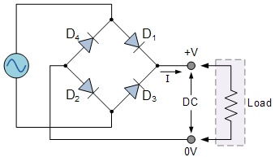
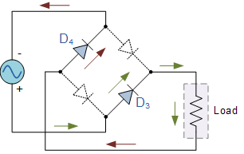
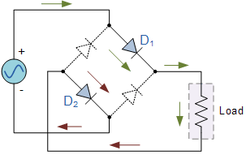
Bridge Rectifier
The 4 diodes are arranged in “series pairs” with only 2 diodes conducting for every half cycle.
During the positive half cycle, diodes D1 and D2 conduct in series while diodes D3 and D4 are reverse biased. The reverse is true for the negative half cycle.

